Slide 1




Presented by:
Anuj Kumar Gupta
Rutvikkumar Bandhaniya
IIIT-Delhi

Slide 2

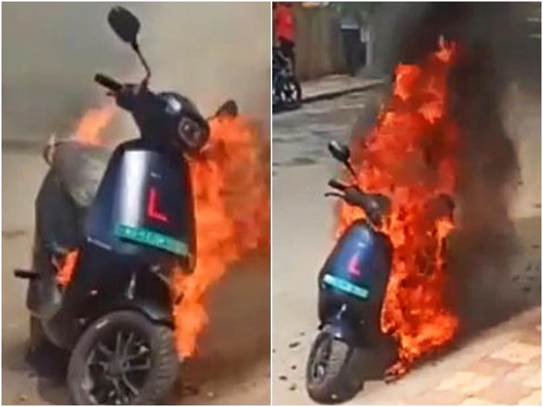

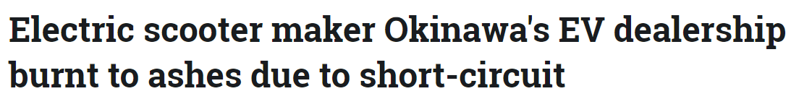

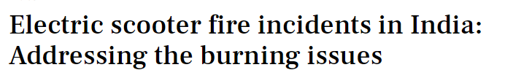
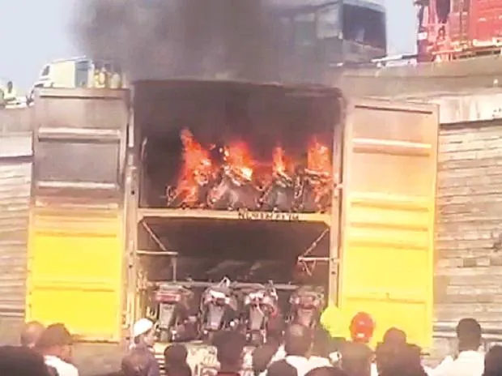





The Problem
https://zeenews.india.com/electric-vehicles/yet-another-okinawa-electric-scooter-catches-fire-entire-ev-dealership-gutted-in-tamil-nadu-2454923.html
https://www.newsbytesapp.com/news/auto/electric-vehicle-fires-in-india-causes-prevention-policy/story
https://www.thenewsminute.com/article/chennai-store-gutted-blaze-after-okinawa-electric-scooters-catches-fire-162975
https://auto.economictimes.indiatimes.com/news/two-wheelers/scooters-mopeds/ola-s1-pro-electric-scooter-catches-fire-in-pune-company-says-will-take-appropriate-action/90460999

Slide 3
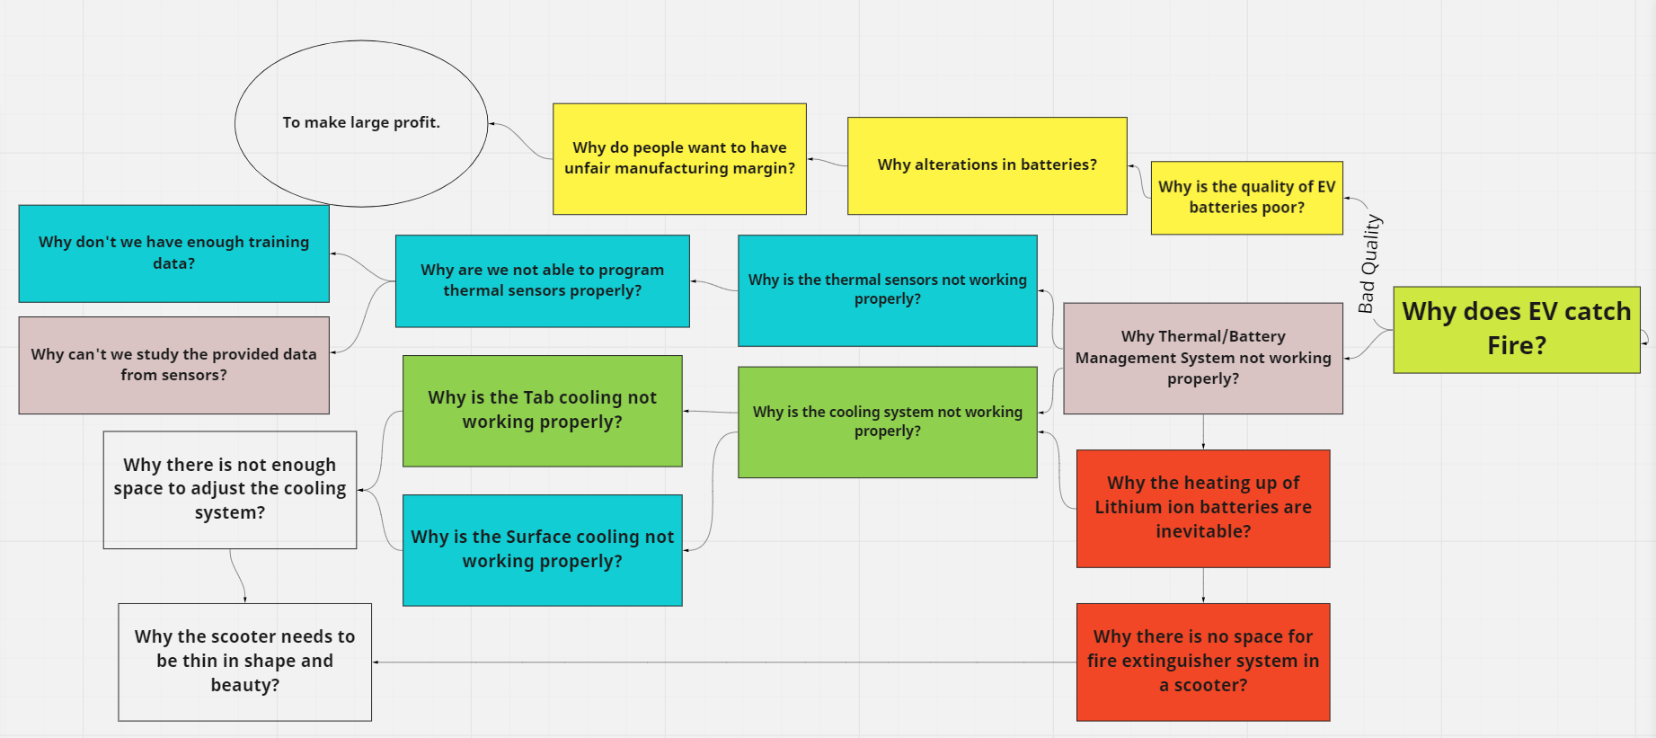
The Research

Slide 4
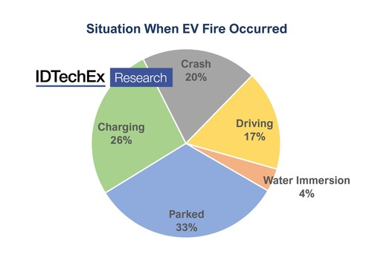
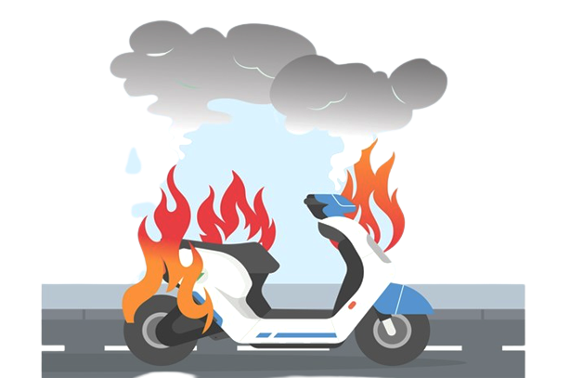
Is EV Scooter Fire Inevitable???
Key Reasons for EV Scooters Catching Fire:
Don’t have enough space for a better cooling system like EV Cars.
Ambient heating in country like India.
IDTechEx Report, “Thermal Management for Electric Vehicles 2021-2031” (www.IDTechEx.com/TMEV) (PRNewsfoto/IDTechEx)

Slide 5
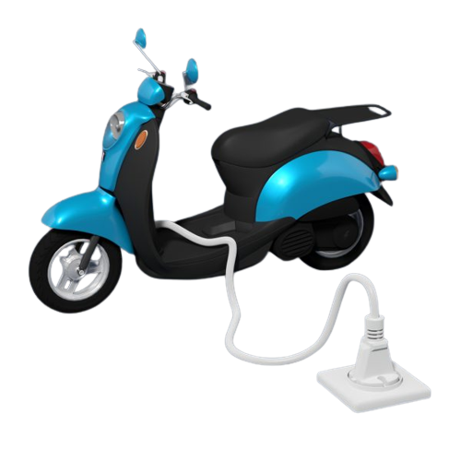
Is there Any Solution
for
EV Scooters Fire???

Slide 6
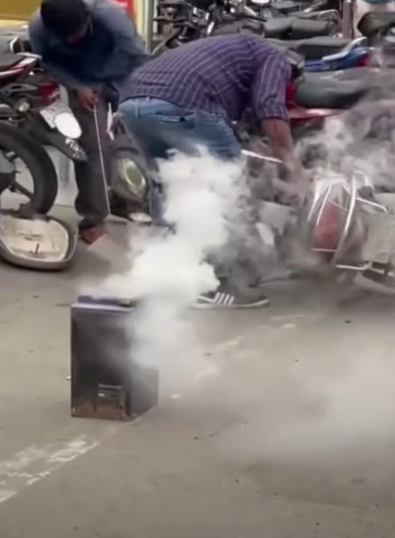


Stages of Catching Fire
Stage 1: Huge Amount of Smoke starts coming out of the battery

Slide 7
Stage 2: Due to continuous supply of Oxygen from its surrounding, this eventually turns into a huge Fire accident

Slide 8
What if we can stop the whole process at Stage 1 only???
The stage where smoke ignition starts!!!

Slide 9
SOLUTION

Slide 10
The First Step:
The Paste

Slide 11
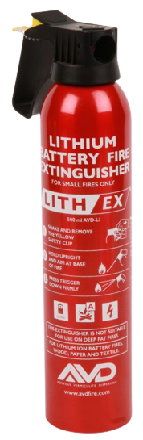


THE PAST
Components of the Solution
PVC Pipes having holes or pores, so that the fire extinguisher can come out
Fire Extinguisher
Type D (500 ml)
OR
Fire Extinguisher Specially made for Lithium Ion Battery fire
Ionization Type Smoke Detectors

Slide 12
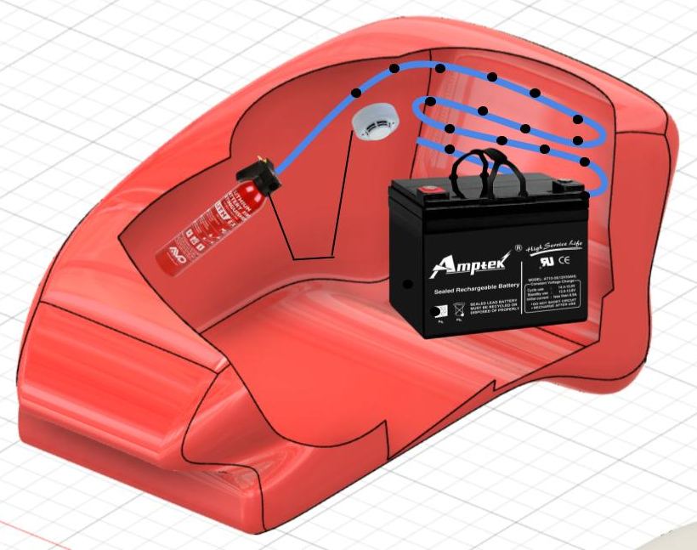
THE PAST
Smoke Detector
PVC pipe with holes
Fire Extinguisher
EV Scooter Battery

Slide 13
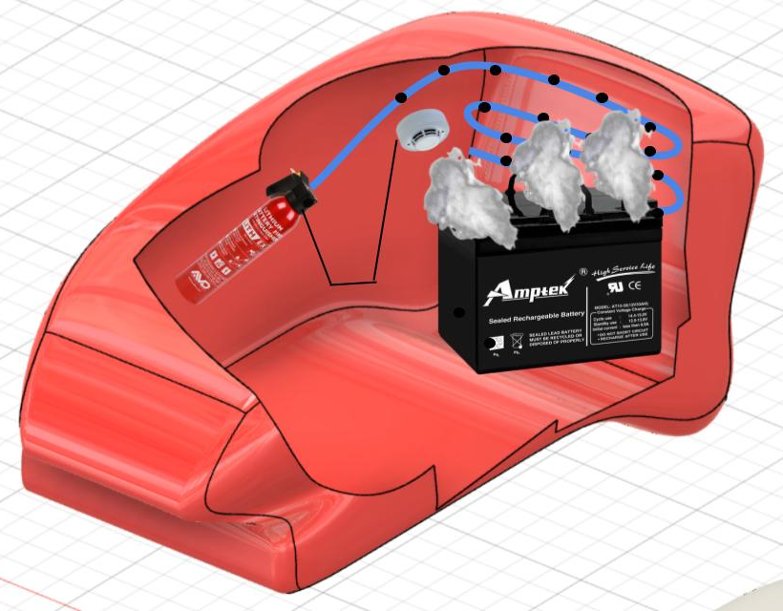
THE PAST
Stage 1: Smoke starts coming out from the battery due to overheating
Smoke ignition from the battery

Slide 14
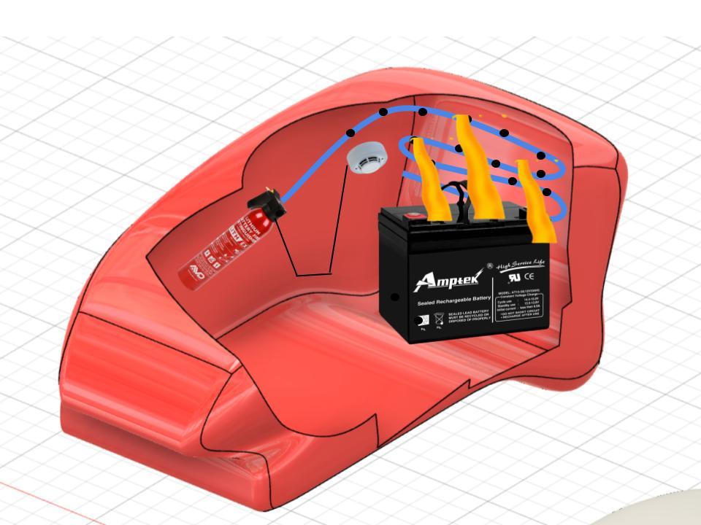
THE PAST
Stage 2: Smoke Detectors enables fire extinguisher and the liquid comes out from the holes of the pipe and hence covering and stopping the flow of oxygen into the battery
Fire Extinguisher liquid

Slide 15

THE PAST
Stage 2: Smoke Detectors enables fire extinguisher and the liquid comes out from the holes of the pipe and hence covering and stopping the flow of oxygen into the battery
Got Selected among top 40 teams among all over India.
The episode will get air in this month.

Slide 16
Next Step:
The Presente

Slide 17
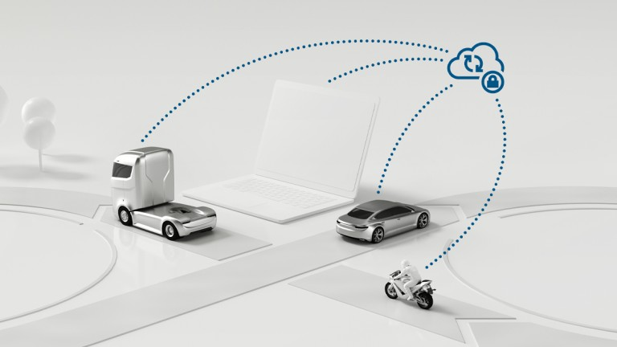
THE PRESENT
Integration of IoT, Cloud with EVs
Connected Vehicle Platform.
IoT enabled connected vehicle platforms for vehicle performance, health, and safety.
Charging and charging station management.
IoT for charging station intelligence, maintenance, and monitoring.
Crowdsource data for Charging station behavior analysis and maintenance.
The smart infrastructure-based intelligent substation for ultra fast charging stations.

Slide 18

THE PRESENT
The Project

Slide 19

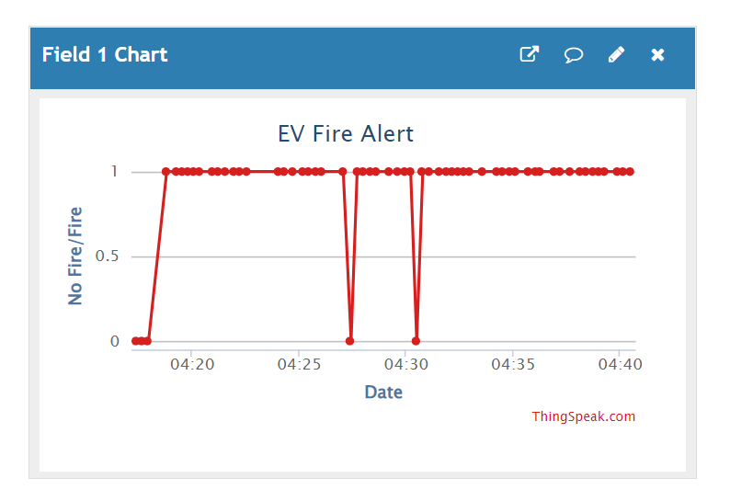
THE PRESENT
The Project
Data will get stored in cloud in the form of graphs and csv file.

Slide 20
The Big Step:
The Futuree

Slide 21
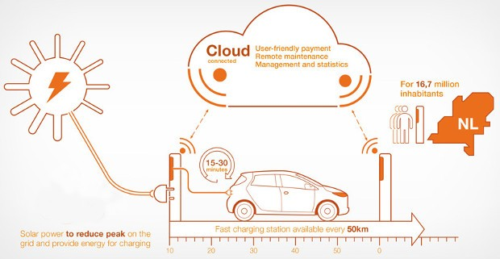
THE FUTURE
Use of Cloud DATA
Now with this data we can do much more:
Analysis of preventive maintenance, Condition monitoring, and accident prevention.
Date and time of the data will help us to predict the future possibilities of battery fire.
Data can be studied to find possible solutions or measures, before the actual accident occurs.

Slide 22
Business Opportunities

Slide 23



What’s Next???
Future Plans:
Analyzing and applying the concepts of Data Science and Machine Learning to get the best out of this data.
Joining hands with private companies and government bodies to help them with this data to Predict, Prepare and Perform the better and more feasible solution for the coming massive EV Boom.

Slide 24
Thank You!
For Any Questions please contact:
anuj18330@iiitd.ac.in
bandhaniya21116@iiitd.ac.in

